Slide 1
Company presentation
FOCUS ON
HEALTH AND SAFETY

Slide 2
About us
SOGESA Consulting was set up in 2006 on the initiative of a group of professionals from a leading global company operating in the field of auditing and consulting.
The Company provides assistance in the field of environment sustainability and integrated quality, environment, safety management systems with specific focus on risk management and compliance.
We have implemented a Quality Management System based on UNI EN ISO 9001:2015, and we are dedicated to achieving and maintaining continual progress over time.

Slide 3
Our vision
The growing attention to environmental and social issues requires companies to implement strategies which go beyond traditional business models, and increasingly take into account the principles of the circular economy and the need to operate with a view to sustainable development
SOGESA supports companies in this process, providing them with professionalism and experience gained in the implementation of complex and innovative projects for leading national and international companies operating in all major industrial and service sectors, for research agencies and public administrations both at local and national level
The belief that effective environmental management is a great opportunity and an important competitive factor is the most important message we want to convey to the companies we work with

Slide 4
Technical and legal advice
We offer a 360° compliance service in the event of litigation or proceedings, assuming if necessary, also the role of technical consultant (CTP)
Environment
Whistleblowing
Sustainability
TECHNICAL ACTIVITIES
Compliance
Assistance in managing and maintaining compliance with compliance with relevant obligations, also through service desk support
General Data Protection - GDPR
Our services
Reporting
Audit
Control of management activities at company level or on specific plants and processes
Risk Management Legislative Decree 231/2001
Emission Trading Scheme
Training
Planning and delivery of training and assistance activities
Health and safety in workplaces, HACCP
Energy

Slide 5
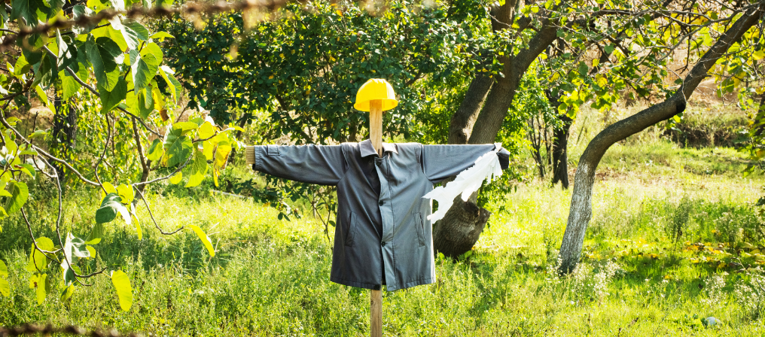
FOCUS
Health and safety in workplaces
Health and Safety assessment audits on activities, sites and plants to ensure compliance with applicable regulations, compliance with contractual or voluntary standards (ISO), but also to identify and assess liabilities or possible liabilities in the case of financial acquisitions and transactions (due diligence);
Definition of the corporate delegation system and the related roles and responsibilities;
Support in obtaining voluntary certifications from the planning phase to the implementation of the system: ISO 45001 to increase health and safety performance;
Support in the processing of the documents required by Legislative Decree no. 81/08 (DVR, DUVRI...) and all other relevant obligations for the Employer, including obligations related to Fire Emergency;
Planning and delivery of training activities in the field of occupational Health and Safety;
Assistance in the management and maintenance of compliance with the relevant obligations, including through a support service desk regulatory update, for example updates of Legislative Decree 81/08.
Assessing risks and defining responsibilities
Implementing prevention and protection measures
Reducing or eliminating the risk of occupational diseases and accidents

Slide 6
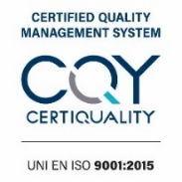
Our corporate offices
With two offices, Rome and Milan, we operate throughout the country and abroad
SOGESA team is available to join you at your company premises or to welcome you to our offices.
info@sogesaconsulting.it sogesaconsulting@gigapec.it
Registered office and operational headquarters: Viale Giuseppe Mazzini, 6 00195 Roma
Milan office: Via Cecilio S. Plinio, 74 20129 Milano
VAT no. Tax Code 09149841000 CCIAA REA 1143178
www.sogesaconsulting.com
Phone and fax 06 8676 0968 - 06 88652283
Phone and fax 02 8434 2339 - 02 84342336
SOGESA Consulting S.r.l.
aderente ad Assolombarda

Slide 7
Main clients
Notes:
Non allineati

